Slide 1
Forge VR Explorer
Shawn Cross
Griffin Gonsalves
Paul Kwak

Slide 2
Main Purpose
Use Vrok.it and Forge API
Increase usability and add slightly more functionality
Upload CAD files
File conversion
Model viewing
VR with Google Cardboard

Slide 3
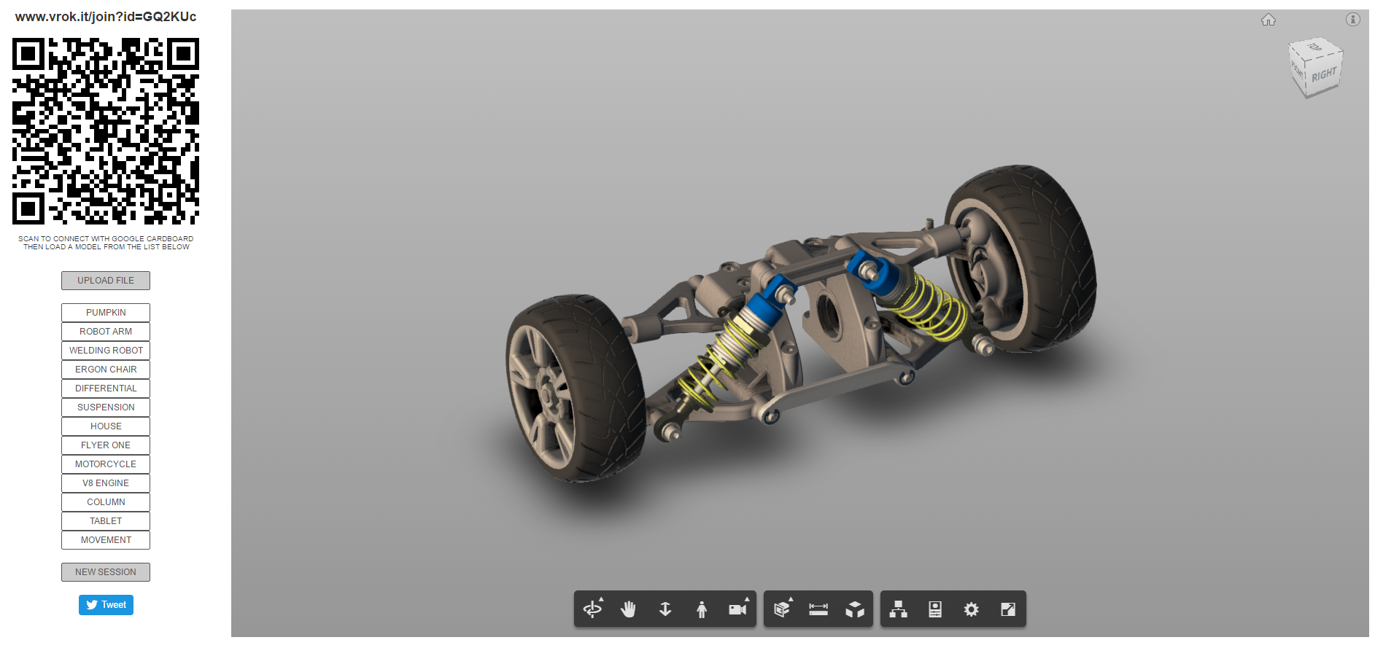

Slide 4
Heroku
Moved project to Heroku
Takes care of the most back end things
Easy to setup
Vrok.it also utilized
Free!

Slide 5
Getting The Website Set Up
Installed heroku and node.js
Edited the credentials in the js files
Created a bucket for files
Filled bucket with some Test files

Slide 6
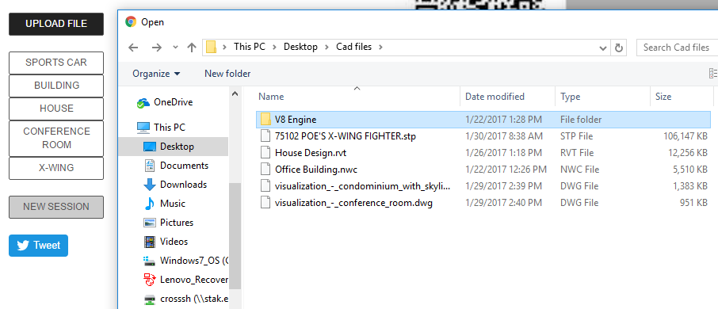
Local File Upload
Model derivative accepts roughly 60 different types of files.
Files Uploaded will be placed in the list of viewable models.
Once successfully uploaded the files will be loaded into the viewer.
Files uploaded will be placed in the
bucket temporally.

Slide 7
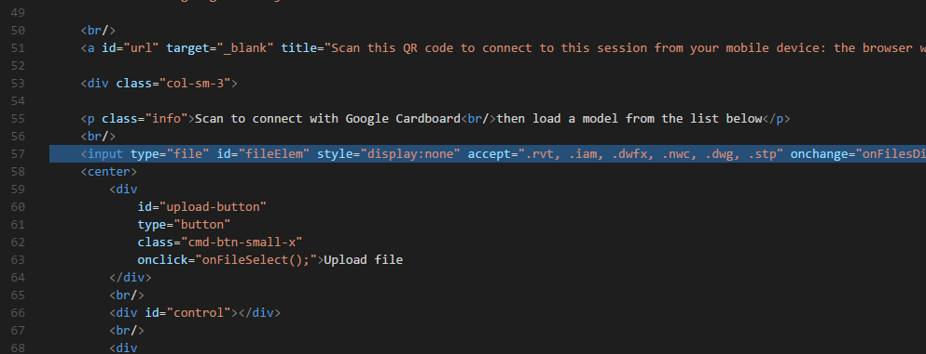
Local File Restriction
Used the html accept attribute to restrict the file types
Only files of the types listed will show up in the file explorer

Slide 8
Node.js
Asynchronous
Server side
Used by vrok.it and API

Slide 9
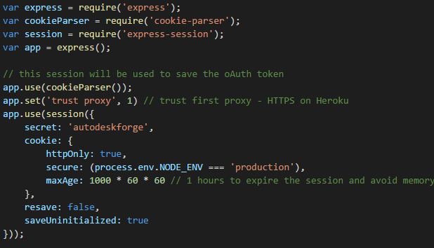
Express.js
Utilized by Vrok.it and API already
Node.js web app framework
Matches on request sent to server

Slide 10
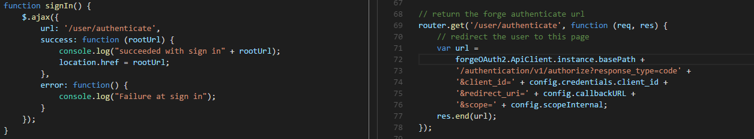
3-Legged Authentication
Url matches and calls function to give url that redirects to Autodesk
Receive URL and redirect to Autodesk to receive token.
Not working as it should…

Slide 11
Non Local File Navigation
Displayed in a file tree
User will be able to navigate to any files in their online storage from Autodesk
Selected Files willed be uploaded to the website
Autodesk API being used

Slide 12
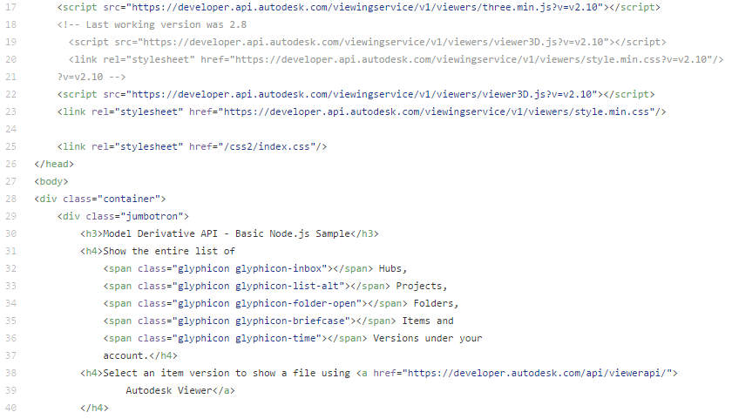
Website Layout
Delays caused challenges
Confusing code
Server backend with Node.js
Multiple CSS files and html index files

Slide 13
Remaining Tasks
CURRENT - Authentication
Data Management functional
Updated UI
Updated Viewer
Google Cardboard

Slide 14
Week by week summary

Slide 15
Winter Week 1
Began to get the website set up
Planned on using github.io

Slide 16
Winter Week 2
Website was more difficult to get setup than we initially thought
switched from using github.io to heroku for server needs
Had to swap out credentials to get site to work properly
Site up and running

Slide 17
Winter Week 3
Troubles setting up file bucket (never used curl before)
Got the bucket setup that will hold the files
Met with Kean and Patti

Slide 18
Winter Week 4
Local file restriction complete
Began working on 3-legged Authentication
Found this would be very hard to do from scratch
Found an API that did exactly what we want
Spoke with Kean about the API we found and decided it would be best to integrate that

Slide 19
Winter Week 5
Began Integration of API
Ran into many problems with the integration
Kean suggested that he could bring in the person that created the API to help

Slide 20
Winter Week 6
Continued to work on integration
Worked on revision for documents to reflect where the project is currently

Slide 21
Problem & Solution - Authentication
One of the biggest problems
Scratch code -> adapting existing code
Not understanding code
Contact with code creator

Slide 22
Problems Solutions
Low communication with client
Not enough questions on our side
Not enough time on theirs
Team work
Better planning
Better communication
Faster help seeking
Client
More question asking
Weekly meetings with client?
Team
More planning
Delegation?
Weekly meetings
Seeking help sooner

Slide 23
What’s next?
Finish the integration of the API
Begin changes to the UI
Testing?

Slide 24
References
https://developer.autodesk.com/
https://github.com/KeanW/vrok-it
https://github.com/Autodesk-Forge/model.derivative-nodejs-sample

